Slide 1
Amazon Sales Analysis Project Report
Insights from Amazon Sales Data

Slide 2
INTRODUCTION
Objective: This report aims to analyze Amazon’s sales data to uncover trends in sales, customer behavior, and product performance.
Scope: We will look at important metrics including sales revenue, product categories, customer demographics, and how sales vary by season.
Context: Amazon is a major global e-commerce platform with a vast range of products and a worldwide customer base. By examining its sales data, we can gain valuable insights to improve marketing strategies and increase sales efficiency.

Slide 3
CONTINUOUS VARIABLE DISTRIBUTION
Unit Price: Most products are priced around $180, which is the median price. The highest price is about $668.27, and the data shows no unusual outliers in the box plot.
Unit Cost: The typical cost of a unit is around $107, according to the median. The highest cost is about $525, and the box plot indicates there are no unusual outliers.
Total Revenue: Most of the revenue is under $750,000, as shown by the median and the tallest bar in the histogram. However, there are three higher-than-usual revenue figures, with the highest reaching about $6,000,000.
Total Cost: Most costs are under $360,000, as seen from the median and the tallest bar in the histogram. Similar to revenue, there are three higher-than-usual cost figures, with the maximum around $4,500,000.

Slide 4
Total Profit: Most profits, calculated by subtracting total costs from total revenue, are around $290,768, based on the median. The box plot shows a few unusually high values, with the maximum profit reaching $1.7 million, which is much higher than the typical revenue.Unit Profit: The profit per unit, found by subtracting unit cost from unit price, generally averages around $74, according to the median. The box plot shows no unusual outliers, with the highest unit profit being about $174.Units Sold: The median number of units sold is about 5,383. There are no significant outliers in the box plot, with the maximum units sold being 9,925 and the minimum being 124.Shipping Duration: Most shipments are completed within 24 days, as shown by the median. There is little variation in the shipping times, and there are no outliers. The longest shipping duration is 50 days, while the shortest is 0 days.

Slide 5
The most common regions are Sub-Sahara Africa (37) and Europe (24). Most of the shipping is happening on Saturday and Wednesday and least on Sunday. Most of the entries are of year 2012 and 2015. Most of the entries are of month Feb, Jul, May, Oct.
CATEGORICAL VARIABLE DISTRIBUTION
MONTHLY SALES TREND
TIME BASED CATEGORICAL DISTRIBUTION
YEARLY SALES TREND

Slide 6
INSIGNTS FROM UNIVARIATE ANALYSIS
Unit Price: The typical unit price is about $180. The highest price recorded is $668.27, and there are no unusual outliers in this data.
Unit Cost: The typical unit cost is around $107. Like unit price, there are no outliers, and the maximum unit cost is $525.
Total Profit: Most of the total profit values are around $290,000. However, there are more than three outliers, with the highest profit reaching about $1.7 million, which is much higher than the average.
Units Sold: Generally, the number of units sold is around 5,383. The maximum units sold is 9,925 and the minimum is 124. There are no outliers in this category.

Slide 7
Shipping Duration: Most shipments take 24 days or less. The longest shipping time is 50 days, and the shortest is 0 days, with no major outliers.
Sales Channel: Sales are evenly split between offline and online channels.
Item Type: The items sold mostly fall into the categories of Clothes, Cosmetics, and Office Supplies.
Region: Sales are most common in Sub-Saharan Africa (37 entries) and Europe (24 entries).Country: Most countries are represented by just one entry, making up 83% of the dataset.
Shipping Day: Shipments are most often sent on Saturdays and Wednesdays, with Sundays being the least common day for shipping.
Month: Shipments are most frequent in February, July, May, and October, with fewer entries in other months.
Year: The majority of entries are from 2012, with a noticeable drop in the following years.

Slide 8
BIVARIATE ANALYSIS
To identify sales trends, we need to analyze them on a monthly, yearly, and year-over-month basis.
We can explore the relationship of these trends with continuous variables, such as:
Total Profit
Units Sold
Additionally, we can examine the relationship between item types and:
Unit Profit
Units Sold

Slide 9
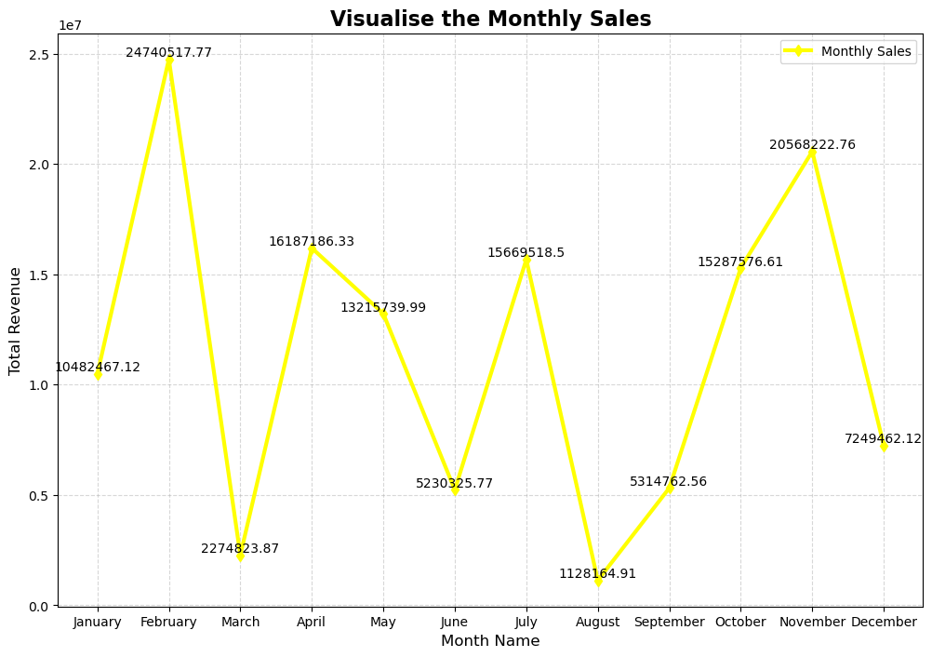
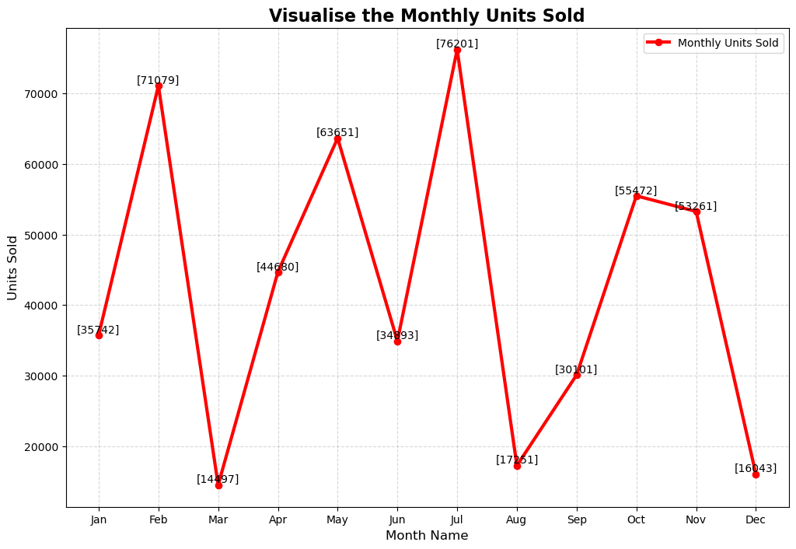
MONTH-WISE SALES
Monthly Revenue
Monthly Units Sold
INSIGHTS:
Highest profit made in month February (approx. $24.5M) and November (approx. $20.3M) and minimum in August (approx. $1.2M) and March (approx. $2.3M)
Highest units sold are in July (76.2k) followed by February(71k), and least in August(14.5k), March(17.2k) and December(16k).

Slide 10
YEARLY SALES
Yearly Revenue
Yearly Units Sold
INSIGHTS:
Maximum Profit is in year 2012 and minimum in 2011.
We can see two peaks one at year 2012 and next at 2014. They are max unit sold in year.

Slide 11
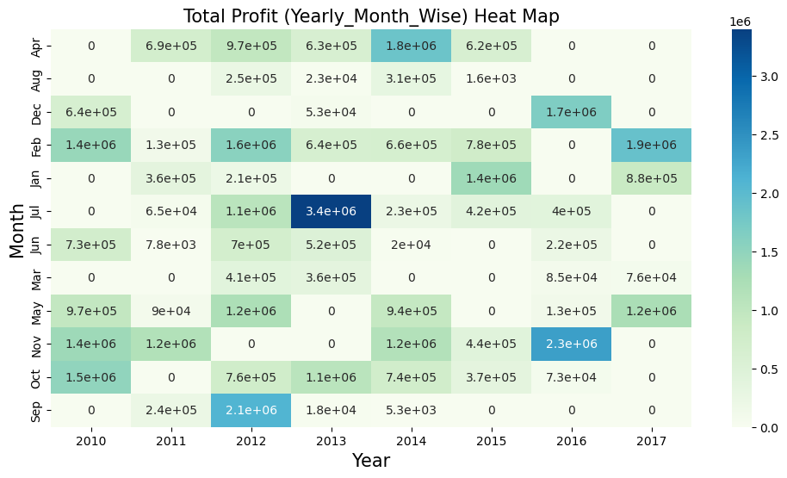
YEARLY-MONTH-WISE SALES AND PROFIT
About heat map between year-month and profit represents the profit in particular month of particular year (for example January 2012 profited an amount of $3.4M).

Slide 12
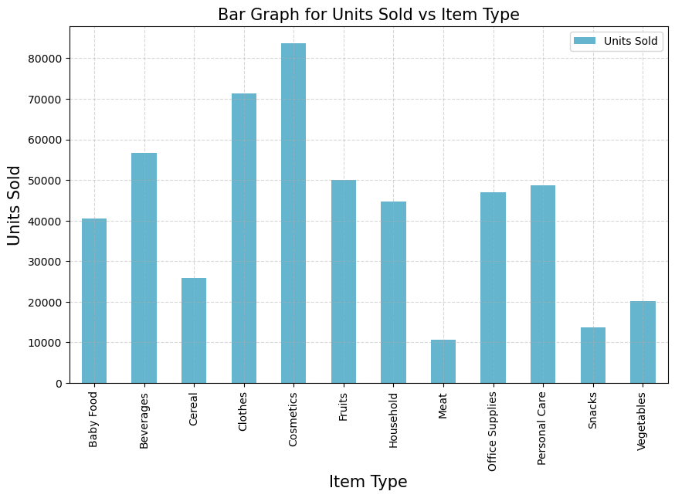
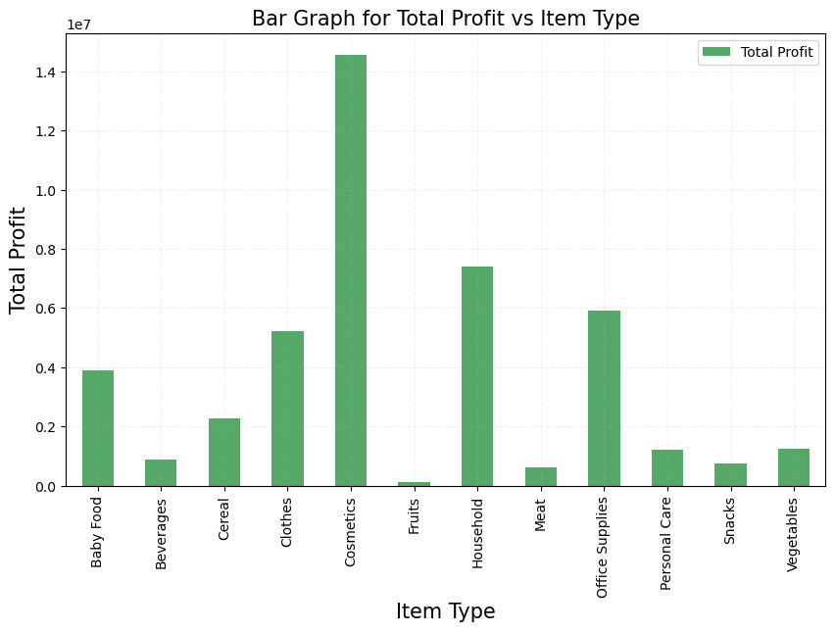
ITEM-WISE SALES AND PROFIT
Yearly Revenue
Yearly Units Sold
Above graphs shows that most items sold are from “Cosmetics” and “Clothes” in left one on the other hand most profitable items includes “Cosmetics” and “Households”

Slide 13
FINAL RESULTS FROM EDA
Unit Price: Most unit prices are around $180. The highest price recorded is $668.27, and there are no unusual outliers.
Unit Cost: The typical unit cost is about $107. The highest recorded unit cost is $525, with no outliers present.
Total Profit: Most total profit values are around $290,000.
Profit Over Time: There are more than three significant outliers. The highest profits are seen in February and November, while the lowest are in March and August. Profit was highest in 2012 and decreased in 2011. Cosmetics generate the most profit, while food items like fruits, beverages, and meat contribute the least.
Units Sold: Most sales involve around 5,383 units. The maximum number of units sold is 9,925, and the minimum is 124, with no outliers noted.

Slide 14
Highest Units Sold: July had the highest sales, with February coming in second. December had the lowest sales.
Peak Sales Years: The highest number of units were sold in 2012, followed by 2014.
Top-Selling Categories: Clothes and cosmetics had the highest sales, while meat had the lowest.
Shipping Duration: Most shipments were completed in 24 days or less, with the longest shipping time being 50 days and the shortest 0 days. There are no significant outliers.
Popular Item Types: The most commonly sold items were clothes, cosmetics, and office supplies.
Top Regions: Sub-Saharan Africa and Europe were the most frequent destinations for shipments.
Shipping Days: Shipments were most commonly sent on Saturdays and Wednesdays, with Sundays being the least common day.

Slide 15
CONCLUSION
Summary of Findings: The analysis of Amazon’s sales data highlighted important trends, such as which product categories are the most popular, when sales peak, and details about customer demographics.
Recommendations: To make the most of these insights, it's suggested to focus marketing on the top-selling product categories, create promotions for specific customer groups, and manage inventory more effectively during busy sales periods.
Future Work: Future research could look into how external factors like the economy affect sales, test different marketing strategies, and gather customer feedback to improve the shopping experience.

